Slide 1

UNIX SHELL PROGRAMMING
THE FILE SYSTEM
PREETHI.P
Department of Computer Science and
Engineering

Slide 2

UNIX SHELL PROGRAMMING
THE FILE SYSTEM
PREETHI.P
Department of Computer Science and Engineering

Slide 3
UNIX SHELL PROGRAMMING
File System
Topics to Discuss:
File and its Type
File name
Parent and child reltaion
Knowing unix file system
pwd and home directory
Absolute pathname
Use of cd
Relative pathname
mkdir, rmdir, cp, rm, file, lp and cancel.

Slide 4
UNIX SHELL PROGRAMMING
File
UNIX looks everything as file
File can be Source code, Executable file.
Directories and devices are all files in the unix
Types: Ordinary file
Directory file
Device file

Slide 5
UNIX SHELL PROGRAMMING
Ordinary File
Traditional File is ordinary or regular file resides on permanent magnetic media.
Contains Data, source programs, object and executable code.
Commands like cat, ls are also treated as ordinary or regular file.
Common type is text file.
Each line is terminated by LineFeed and end of the file is denoted by eof.

Slide 6
UNIX SHELL PROGRAMMING
Directory File
Contains no external data
Details of the files and subdirectories are stored
Contains two fields
1. Name and 2. identification number (inode)

Slide 7
UNIX SHELL PROGRAMMING
Device File
Printers, tapes, CD-ROM’s, Hard disk, Terminals are all treated as Device files.
Let us take how it works with printers:
Printer will be associated with a file. When you issue a command the file contents will be directed to printer file

Slide 8
UNIX SHELL PROGRAMMING
File name
Name : 255 characters
Valid file names: name , .xyz, xyz., -{}, @^%##
Invalid file names: /. Not valid

Slide 9
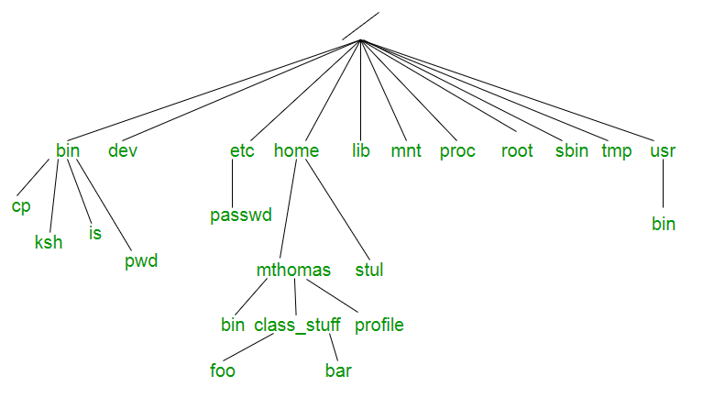
UNIX SHELL PROGRAMMING
Parent child relationship
Image reference: linuxstories.com

Slide 10
UNIX SHELL PROGRAMMING
FILE directory structure
/bin and /usr/bin – unix commands
/sbin and /usr/sbin – Conatins system administrator files and commands
/etc – configuration files
/dev – device files
/home – all users
/tmp – temporary files
/var – print jobs, mail queus, incoming mail etc.
/lib – library files

Slide 11
UNIX SHELL PROGRAMMING
Pathnames
Absolute pathnames:
Ex: Cat /home/romeo/login.sql Can be used form any directory
/bin/date
Relative Pathnames:
Cd ..
Cd .
Cd ../d

Slide 12
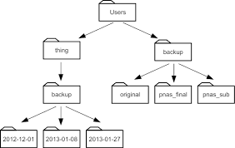
UNIX SHELL PROGRAMMING
Pathnames – Demonstration
cd /users/backup/original if user is in thing
Image ref: datacarpentry.com

Slide 13
UNIX SHELL PROGRAMMING
Pathnames – Demonstration
cd ../backup/original if user is in thing
if user is in backup then cd ../../backup/original
Image ref: datacarpentry.com

Slide 14
THANK YOU
PREETHI.P
Assistant Professor , Department of Computer Science
preethip@pes.edu

